Slide 1


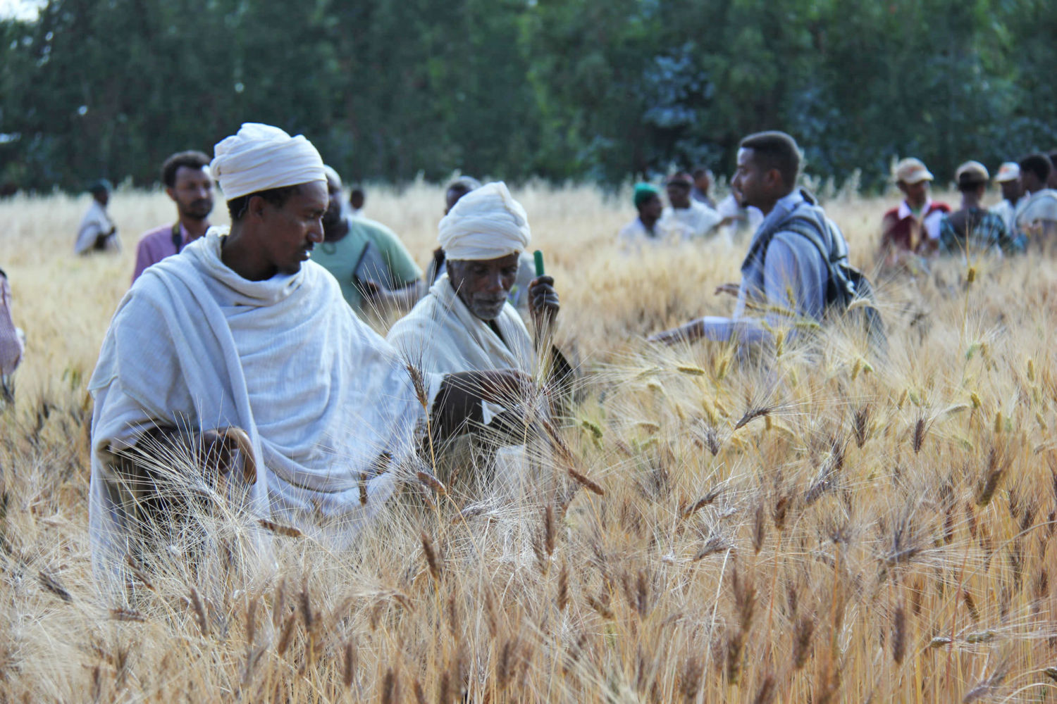
Crowdsourcing citizen-science for farm diversification and adaptation: evidence from three continents
Bioversity International, Information Services and Seed Supplies

Slide 2
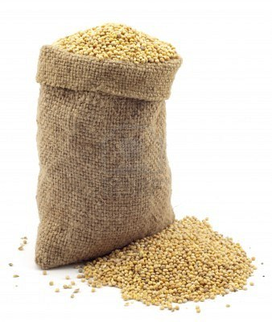
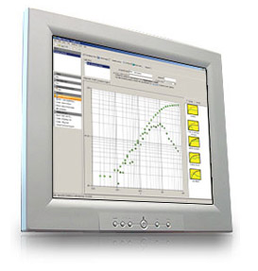
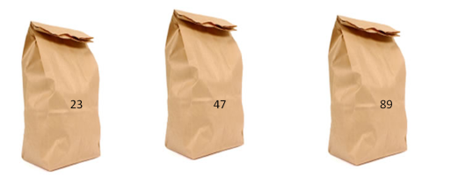
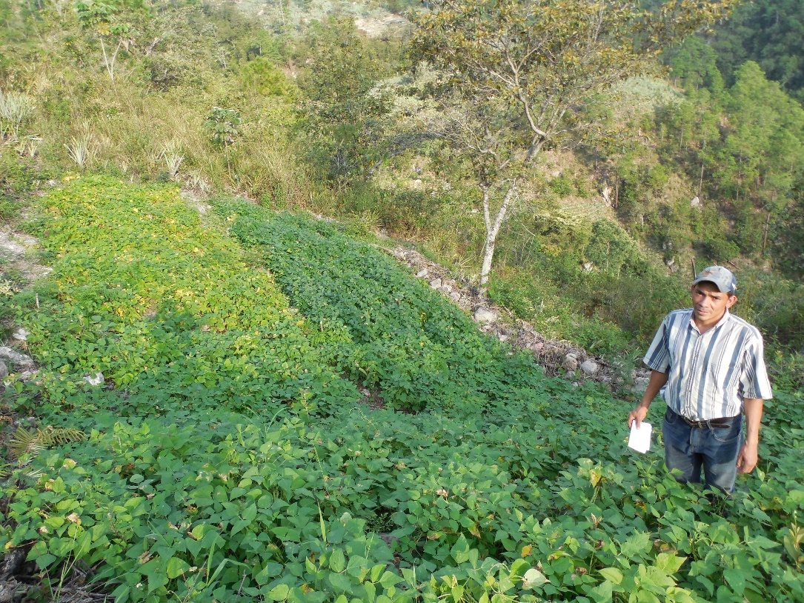

The cycle of tricot research
1. A broad set of varieties (10-25) is evaluated
5. Data are used to evaluate varieties and to detect demand for new varieties and traits
A > C > D
C > D > G
A > D > G
A>C>D>G
6. Farmers receive variety recommendations and can order seeds
2. Each farmer gets a combination of 3 varieties
3. Farmer plants a trial and makes observations
4. Project managers collect farmers’ observations by phone
van Etten et al. (2016) Expl. Agric.
Beza et al. (2017) PloS ONE 12(5):e0175700
Notes:
The ultimate aim is that the whole seed system becomes more responsive. Information goes around to keep constantly adapting to change, matching seeds to emerging needs.

Slide 3



> 22k
on-farm trails
> 170
varieties
3
continents

Slide 4
What we learned

Slide 5
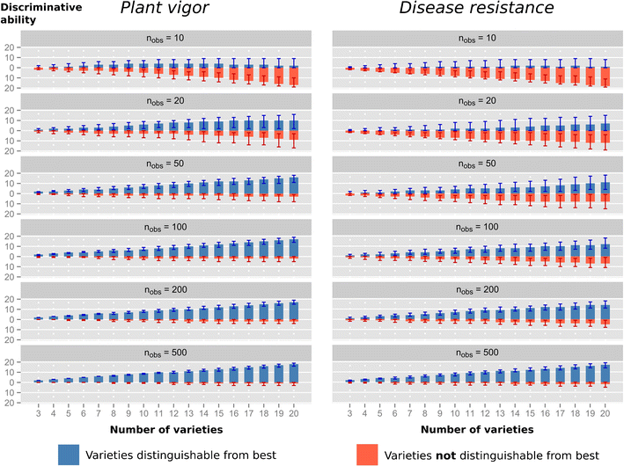
Farmers’ generated data is reliable
Steinke et al. (2017) Agron. Sustain. Dev. (2017)37:32

Slide 6
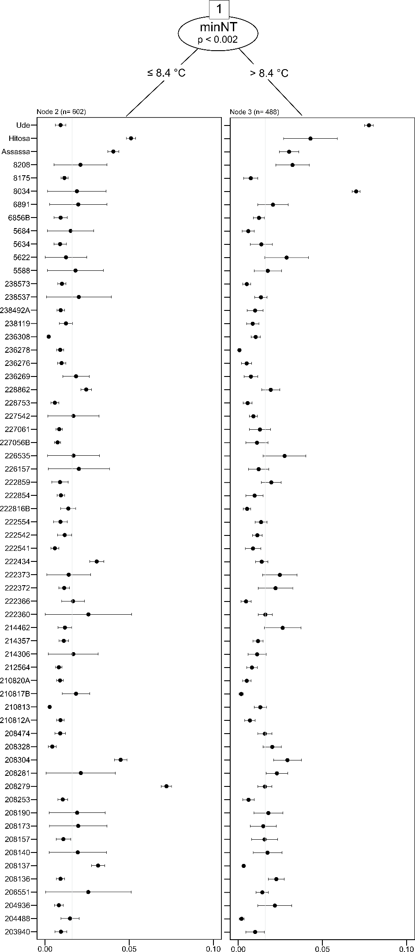
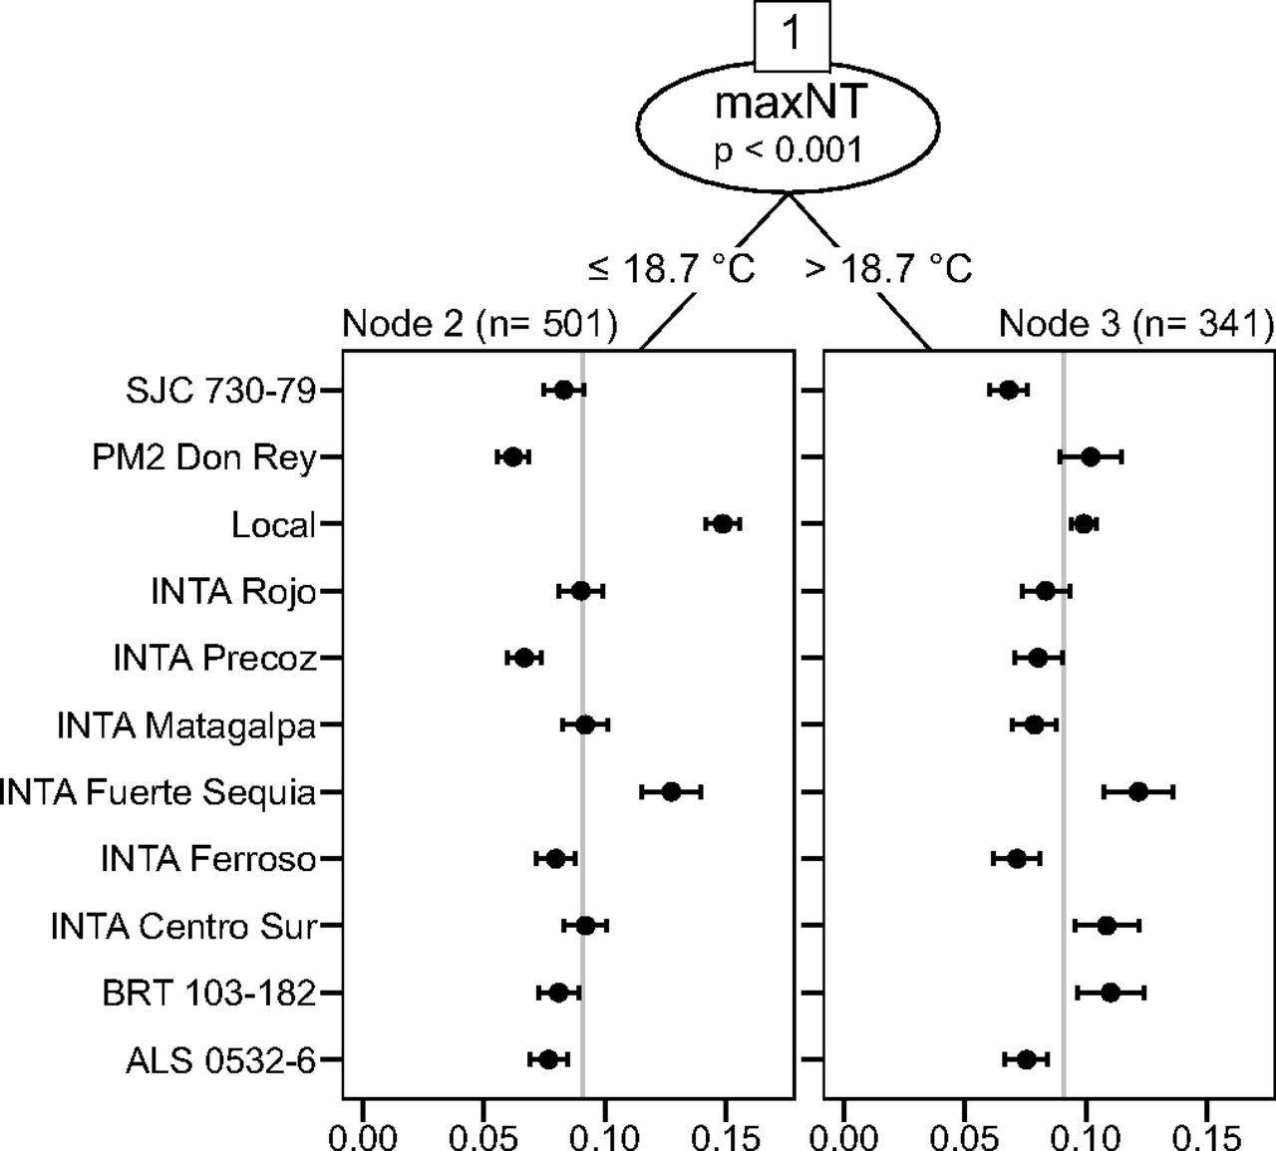
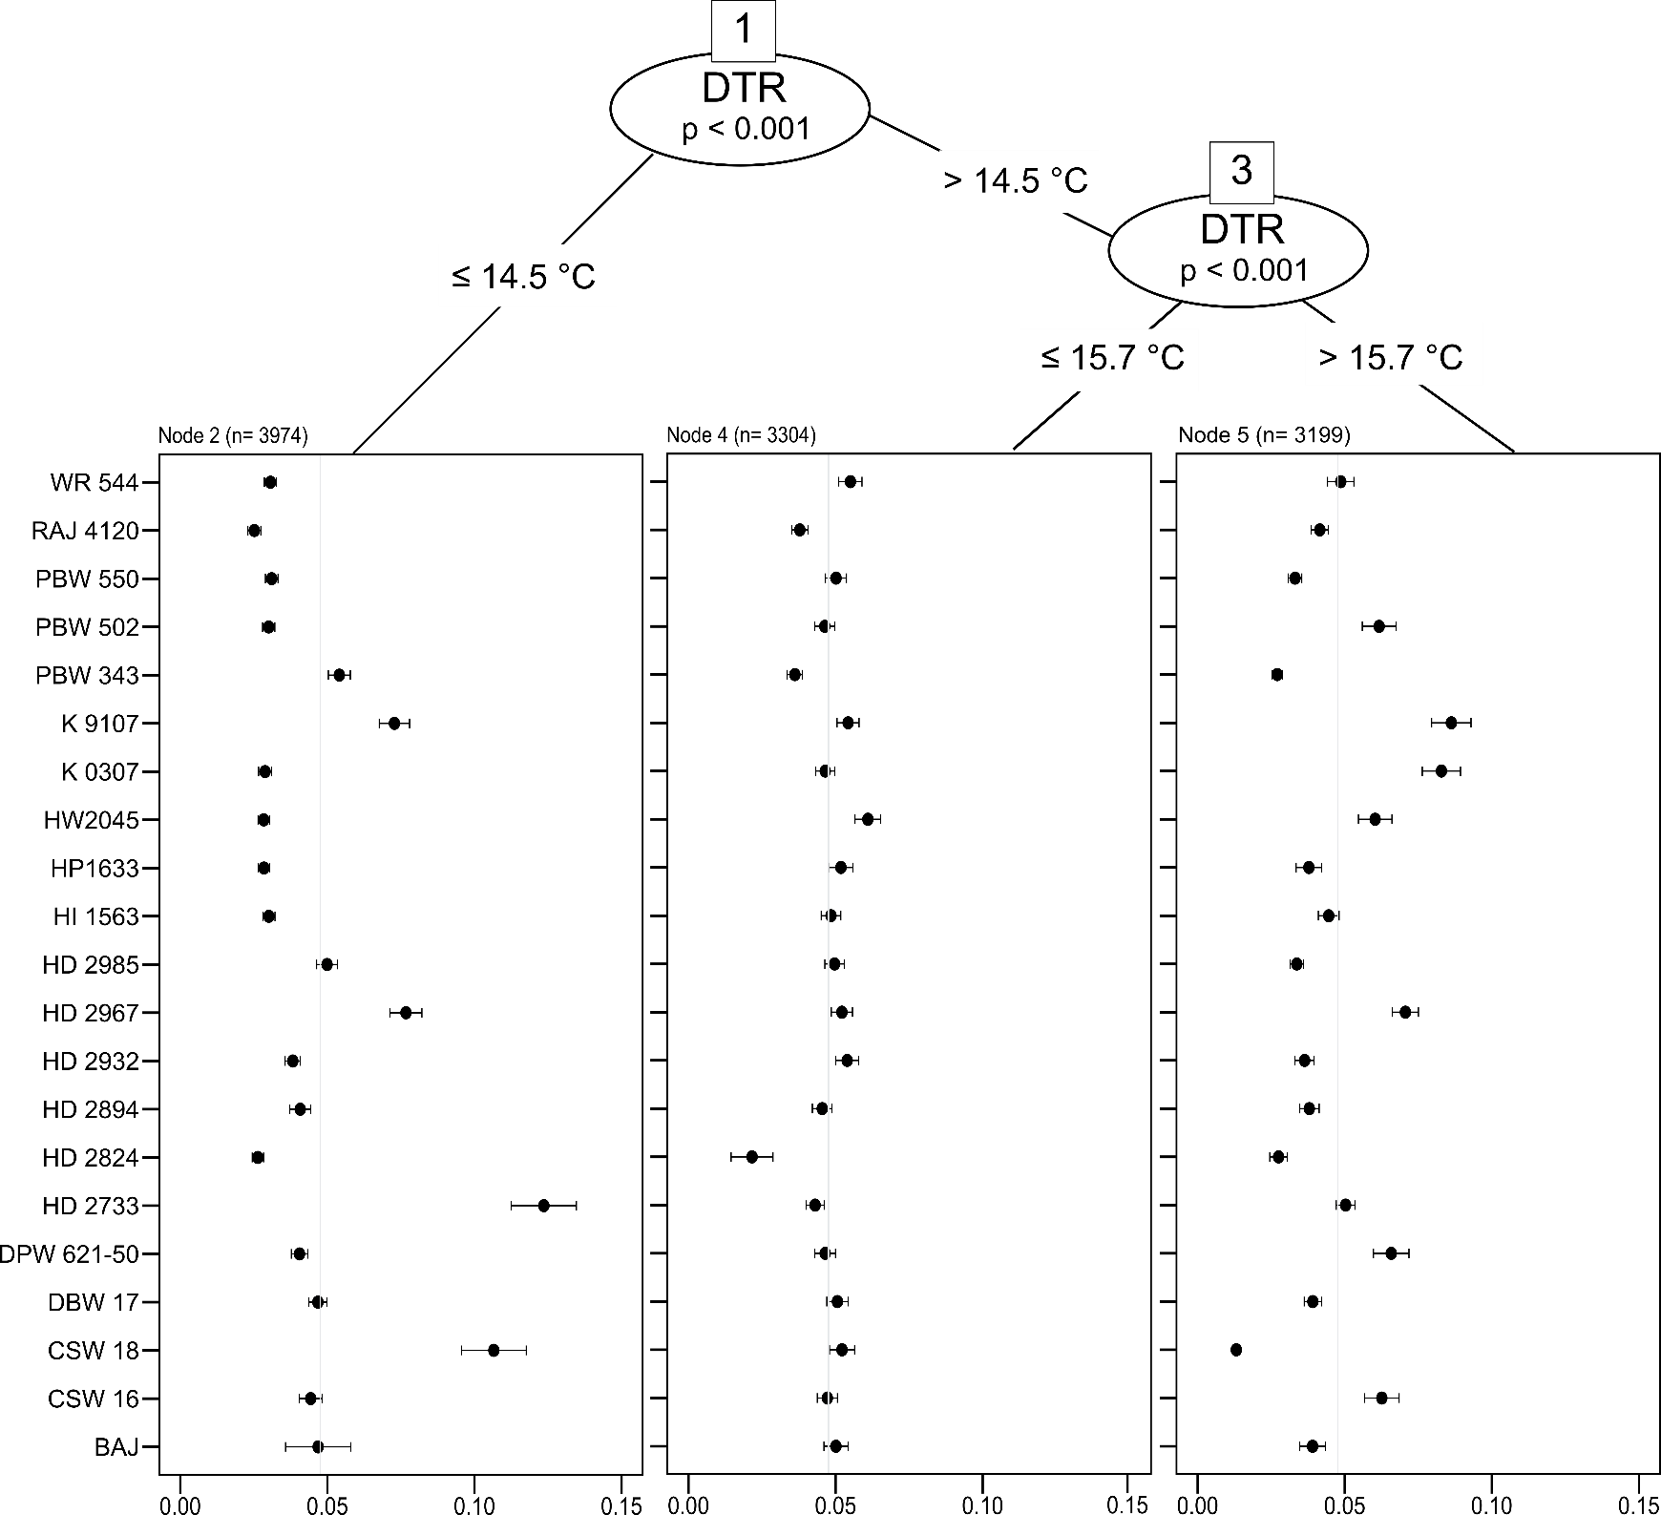
Register the effects of climate on crop performance
Common beans - Nicaragua
van Etten et al. (2019) PNAS 116(10):4194-4199
Bread wheat - India
Durum wheat - Ethiopia

Slide 7
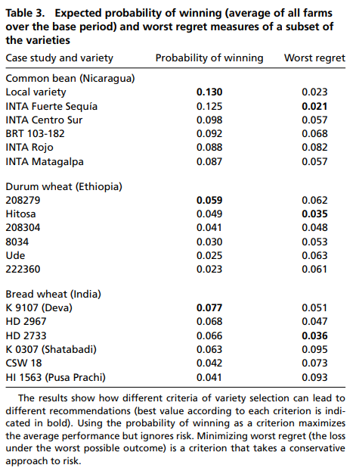
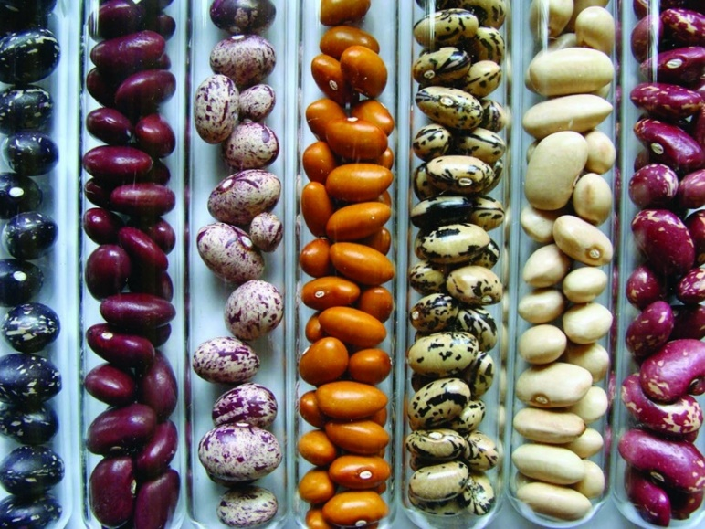
Support risk analysis
van Etten et al. (2019) PNAS 116(10):4194-4199

Slide 8
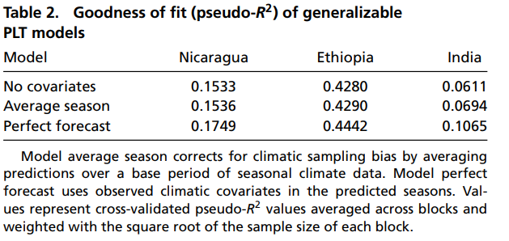
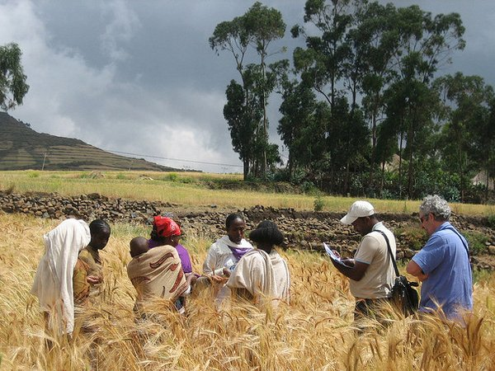
Improve variety recommendations by incorporating seasonal forecasts
van Etten et al. (2019) PNAS 116(10):4194-4199

Slide 9
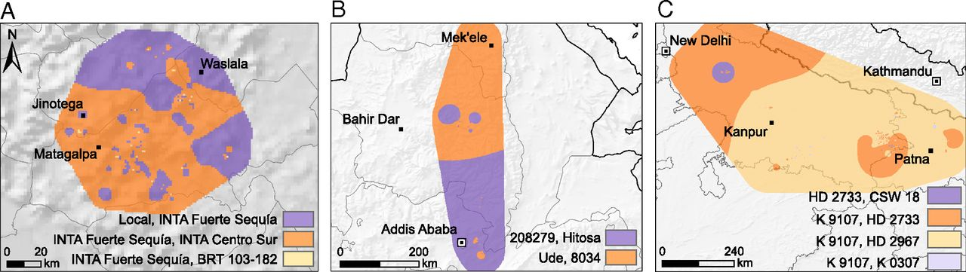
Improve variety recommendation for climate adaptation
Variety recommendation
van Etten et al. (2019) PNAS 116(10):4194-4199

Slide 10
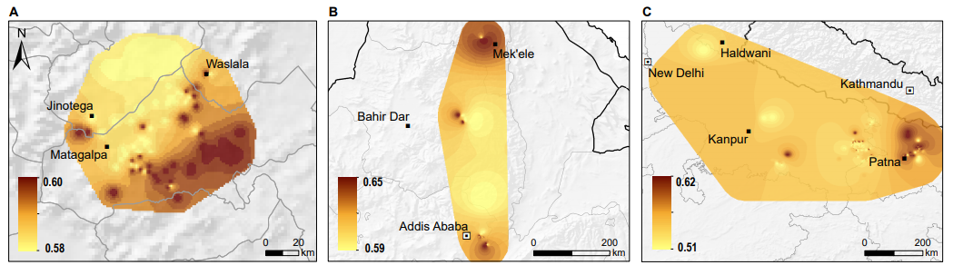
Improve variety recommendation for climate adaptation
Probability of outperforming
van Etten et al. (2019) PNAS 116(10):4194-4199

Slide 11
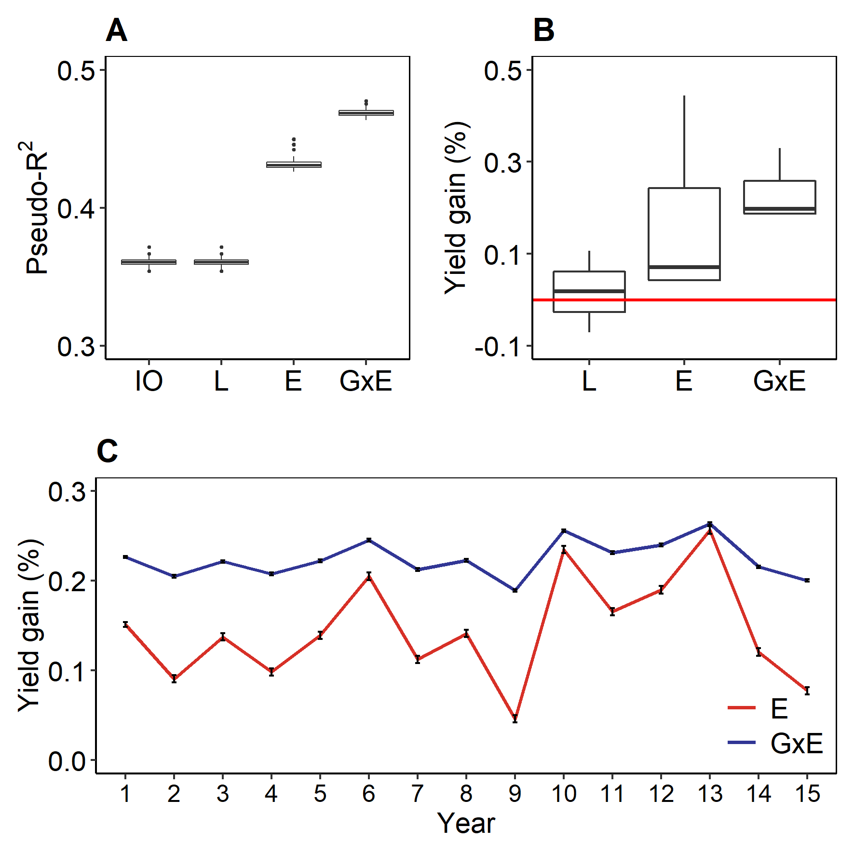
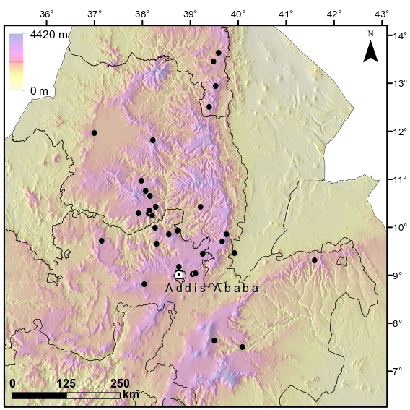
Citizen science to detect GxE interactions
Durum wheat
1070 farmer plots
40 accessions
Genotyped with Illumina 90K SNP array
de Sousa et al. (under development)

Slide 12
Farmers keep crop diversity

Slide 13
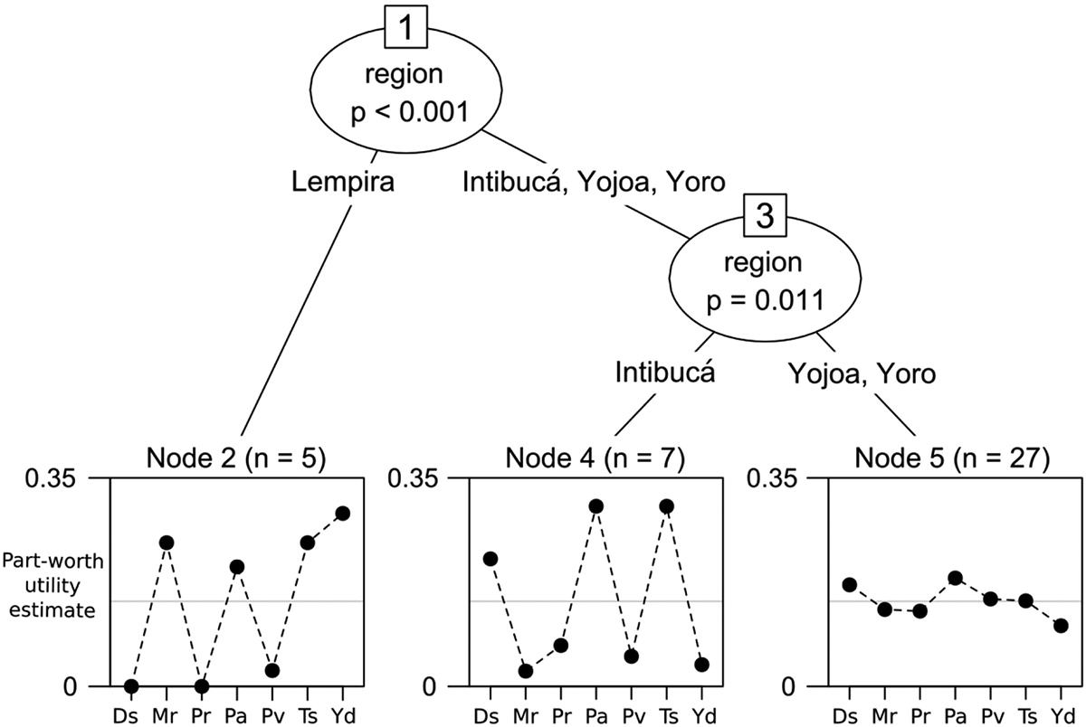
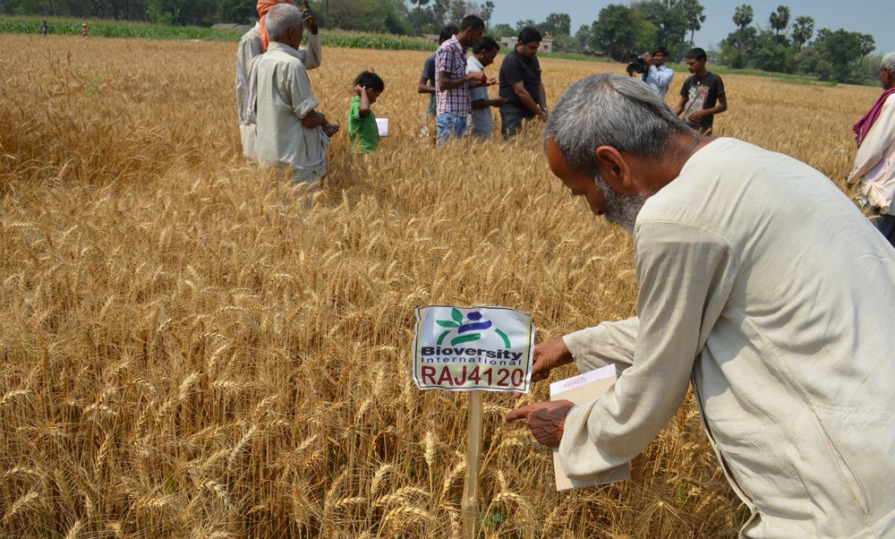
Different priorities among groups
Ds = Disease resistance, Mr = Market value,
Pr = Pest resistance, Pa = Plant architecture,
Pv = Plant vigor, Ts = Taste, Yd = Yield
Steinke and van Etten (2017) J. Crop Improv. 31(3):356-378

Slide 14
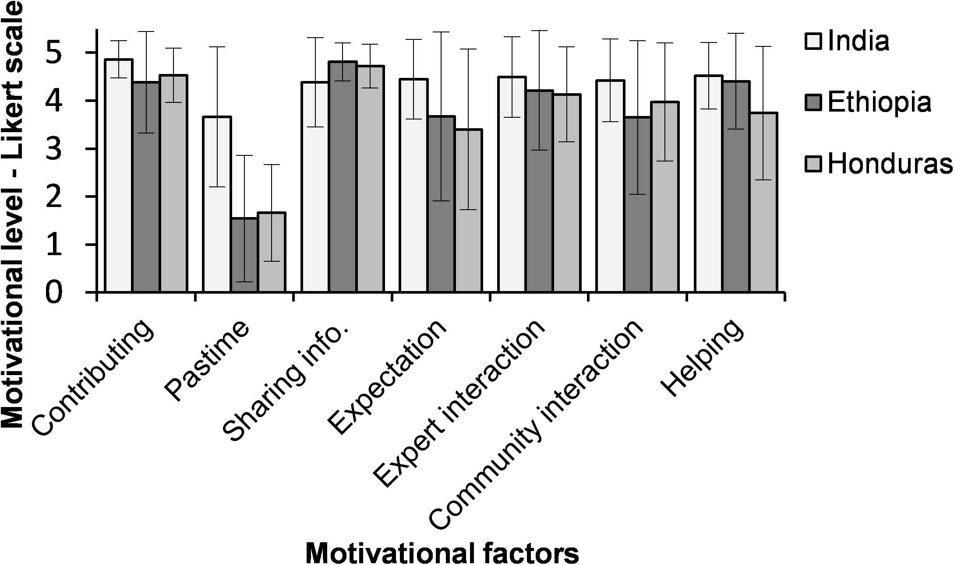
Different motivation factors to participate
Beza et al. (2017) PlosOne 12(5):e0175700

Slide 15
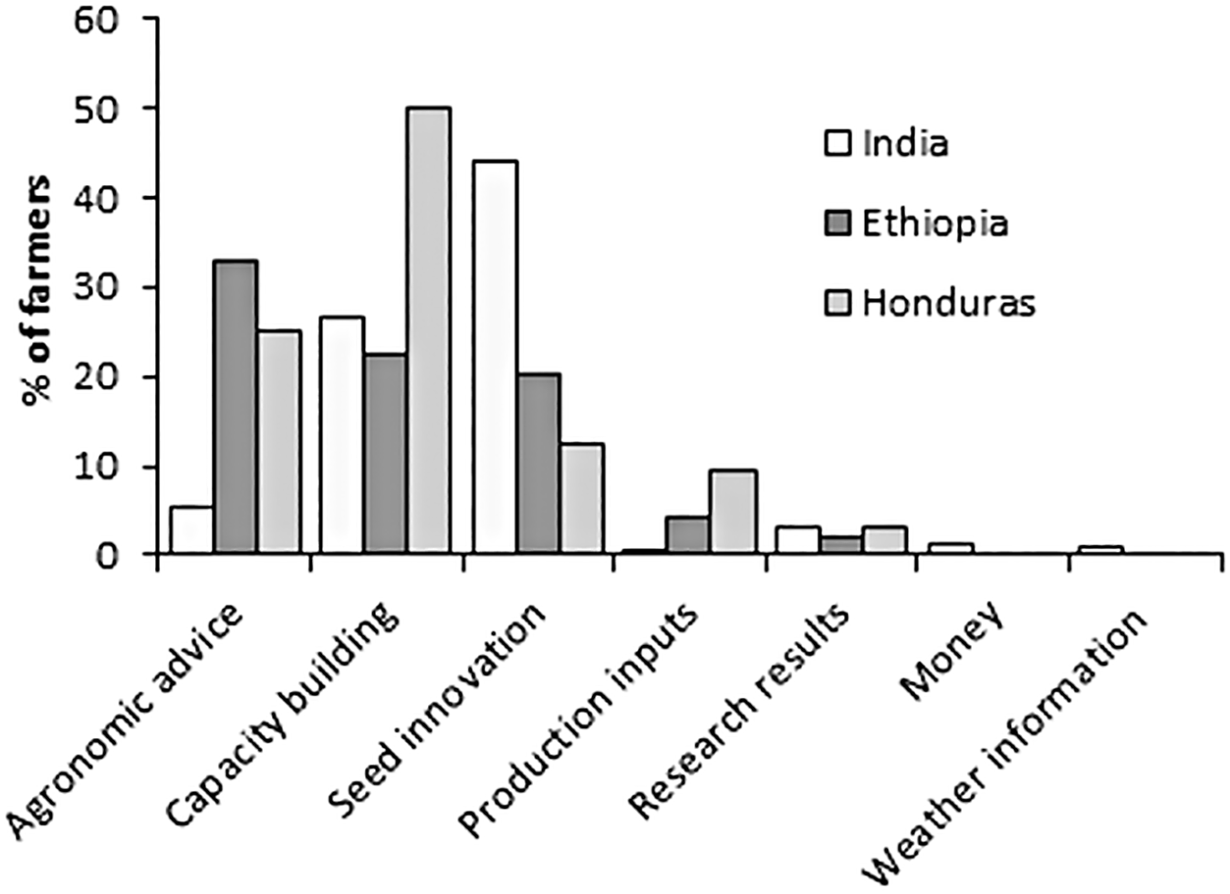
Expected return factors for the contribution in tricot projects
Beza et al. (2017) PlosOne 12(5):e0175700

Slide 16
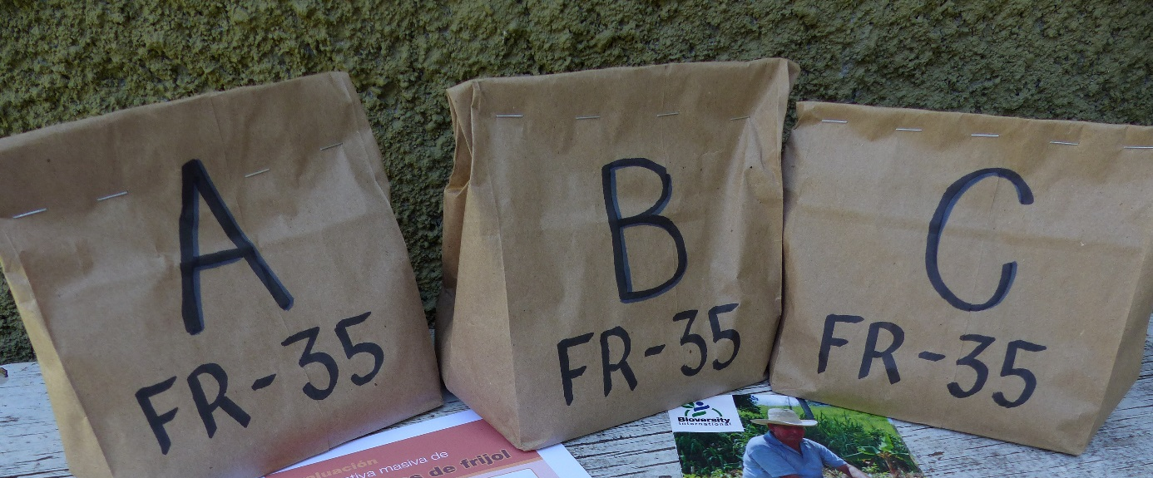
Effects: Up-scaled diverse seed production in Honduras
Many more farmers want to participate in crowdsourcing
Local NGO sells tricot packages as “diversity test kits”
“Local farmer research committees” now produce seed of many varieties commercially
Tricot has created local demand for diversified seed businesses

Slide 17

Is a cost-effective approach
Common beans projects in Central America
41.01 USD
33.43 USD

Slide 18

Thank you!

Slide 19
This is a compilation of several presentations of the members of Bioversity International’s “Information Services and Seed Supplies” Team. If you intend to cite it please do it as:
de Sousa, K; Steinke, J.; van Etten, J. (2019) Crowdsourcing citizen-science for farm diversification and adaptation: evidence from three continents.
Other materials used in this training course are available at:
https://github.com/agrobioinfoservices/training
For the editable .ppt files, please send a request to
k.desousa@cgiar.org

